Slide 1

Basic course5-Automatic lighting
Yahboom
Yahboom OMIBOX Tutorial

Slide 2
1
2
3
4
5
Learning
goals
Search for
blocks
Combine
blocks
Experimental
phenomena
Preparation
程序编程
Tencent
Yahboom OMIBOX Tutorial

Slide 3
1
Preparation-1
1. The position of the Photo-resistor in the robot car
2. Learn how to use Photo-resistor graphically program building blocks
Yahboom OMIBOX Tutorial

Slide 4
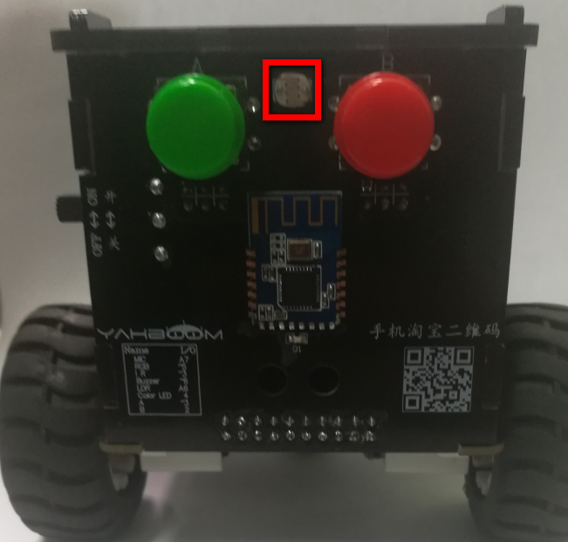
1
Preparation-2
As shown in the figure above, we circled the red wire frame with a Photo-resistor, and we can use it by programming.
Yahboom OMIBOX Tutorial

Slide 5
2
Learning goals
In this lesson, we will learn about the use of Photo-resistor. When the light intensity is weak (night), the lights are on; when the light intensity is strong (day), the lights are off.
Yahboom OMIBOX Tutorial

Slide 6
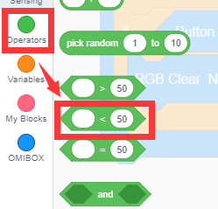
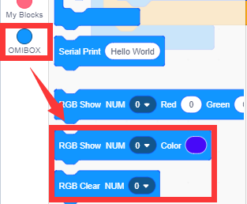
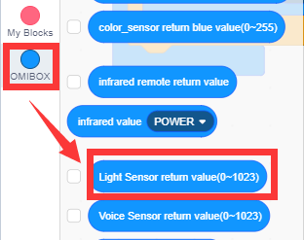
3
Search for blocks
The following is the location of the building blocks required for this programming.
Yahboom OMIBOX Tutorial

Slide 7
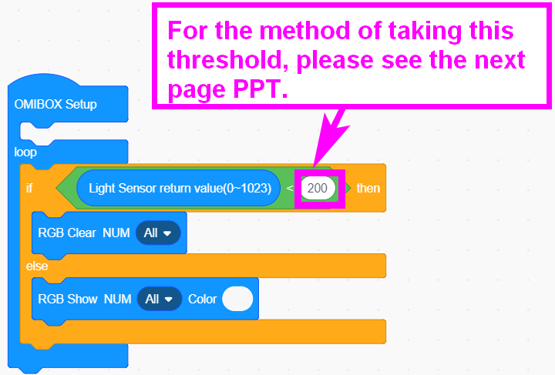
4
Combine blocks
The summary program is shown below:
Yahboom OMIBOX Tutorial

Slide 8
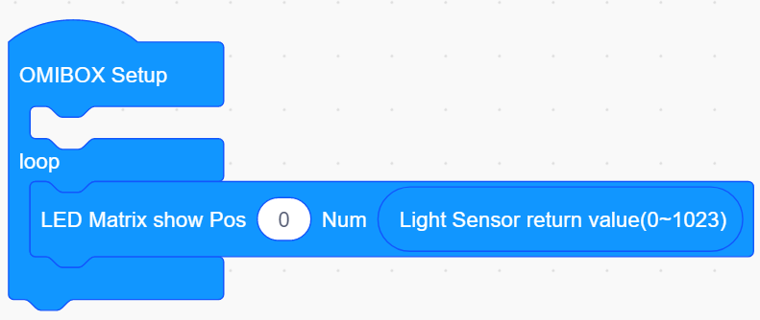
4
Combine blocks
1)Write the program shown below to display the value of the Photo-resistor output on the dot matrix.
Yahboom OMIBOX Tutorial

Slide 9
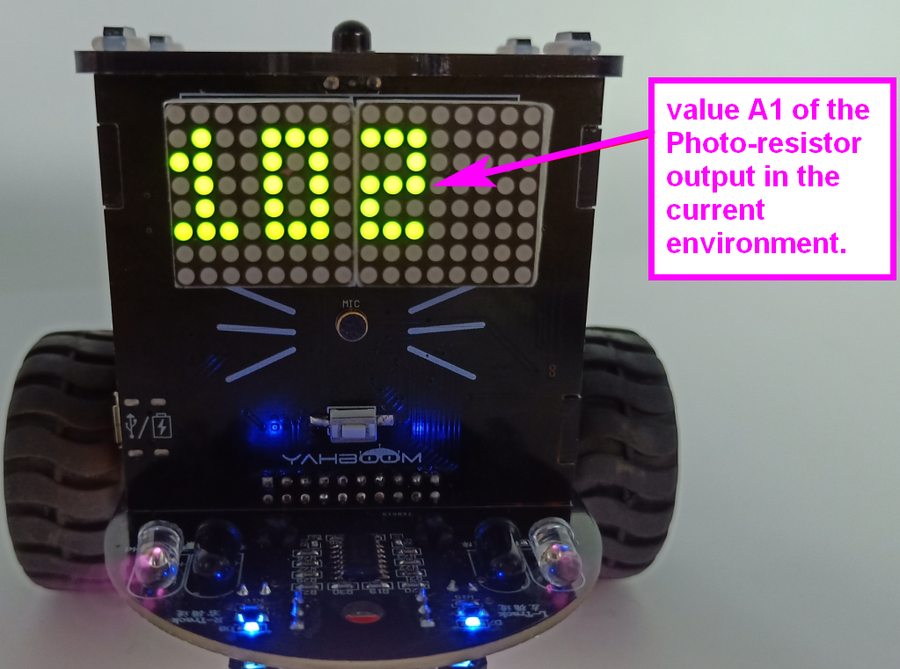
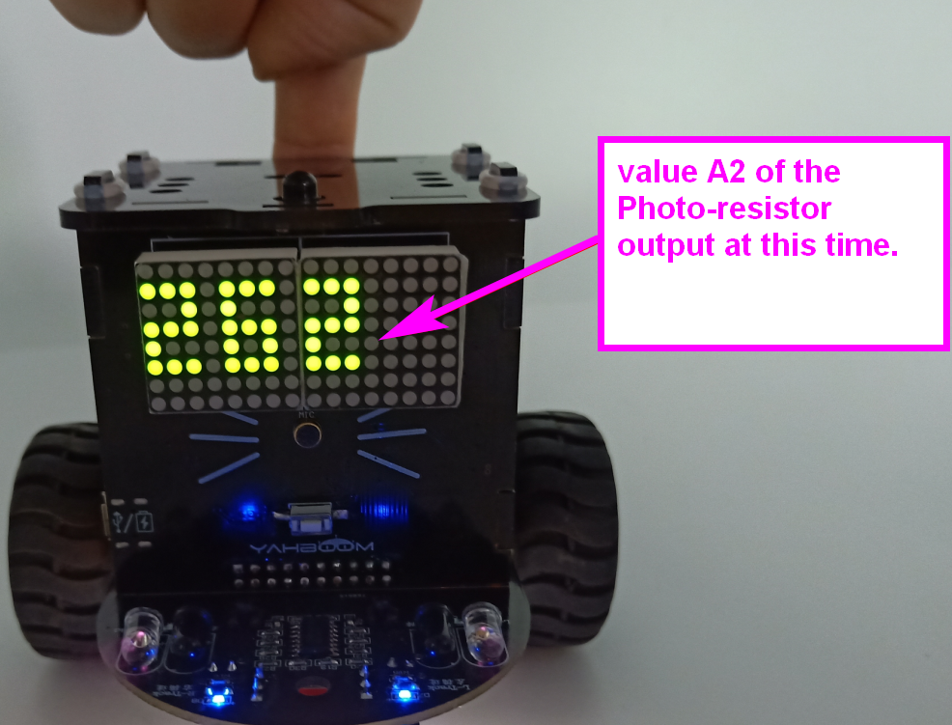
4
Combine blocks
2) Record the value A1 of the Photo-resistor output displayed on the dot matrix in the current environment.
3) Cover the light source sensor by your hand and record the value A2 of the Photo-resistor output displayed on the dot matrix at this time.
4）The threshold is a value in the middle of A1, A2.
Yahboom OMIBOX Tutorial

Slide 10
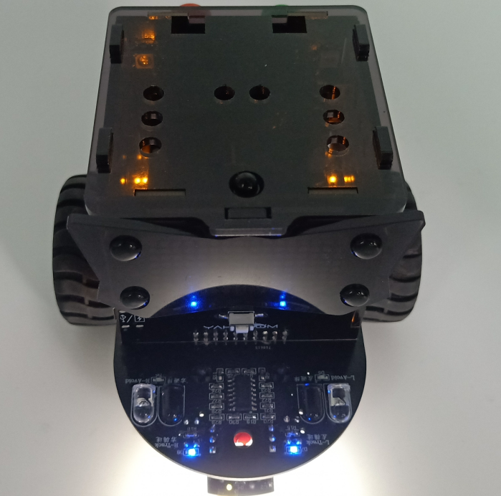
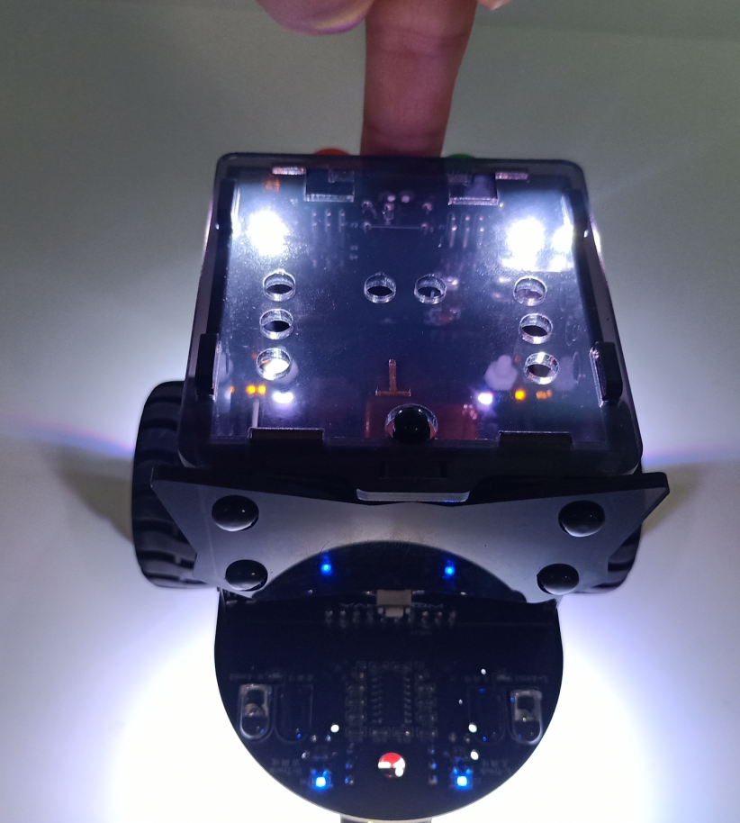
5
Experimental phenomena
After the program is uploaded, the car is powered on normally. When the light is in a dark environment, the lights are turned on. When in a hight-brightness environment, the lights will be closed.
Yahboom OMIBOX Tutorial

Slide 11
Inspire Creativity Embrace Innovation
Thank you!!!
Yahboom

